Slide 1
Marketing Your Appraisal Firm in the Digital World
June 25, 2018
Michael Hobbs, MAI, SRA, LEED GA
President
Notes:
Introduction – Alter the slide to fit your purposes - please mention anything else that the person who introduces you may have missed. Be sure to send a bio ahead of time, but bring a printed version anyway because sometimes they’ll forget.

Slide 2
Introductions
Name
Where are you from?
Title & Size of firm (headcount)
How competitive is your market?
What do you want to learn today?
WRITE THESE DOWN – 30 seconds

Slide 4
Why It Matters!
84% Sphere of influence more important that advertisting (Neilsen)
77% Look for advice, information or help online (Mention)
91% B2B decisions influenced by WOM (USM – Incite Group)
90% of world data generated in previous 2 years (IBM Analytics)

Slide 5
Why It Matters!
2.5 quintillion bytes of data every day or (1 followed by 18 zeros)
2,500,000,000,000,000,000

Slide 6
Notes:
WHY we’re able to do it

Slide 7
So, WHY should an appraiser care about marketing in the digital world? What is the Value?

Slide 8
Without a Plan, Every Path is Good

Slide 9
Amazing Resource In Our Industry

Slide 10
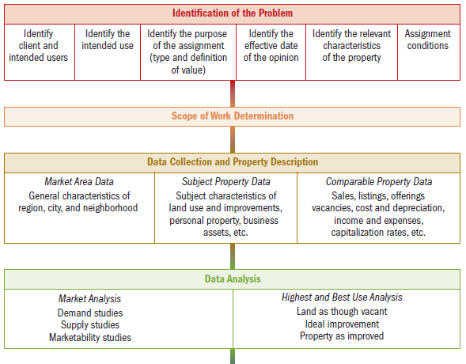
Using The Valuation Process to Solve our Problem

Slide 11
The Valuation Process - Identification of the Problem
Client: ICAP
Users: 2018 Lisle Attendees
Use: To counsel peers regarding probable effects of proposed actions
Type of Value: Market Value (collective value of opinions of market participants)
Effective Date: Today
Relevant Characteristics: Online presence
Assignment Conditions: None
Extraordinary Assumption: None

Slide 12
The Valuation Process – Scope of Work Determination
….type and extent of research needed to solve the problem…
Market research, Marketing firms
Internet search engines
Research reports
Existing appraisal firms’ websites

Slide 13
The Valuation Process – Data Collection & Property Description
Market Area Data – Technology past and present
Subject Property Data – Your marketing & your website & your online presence
Comparable Property Data – Your competitor’s marketing & website

Slide 14
That Was Then

Slide 15
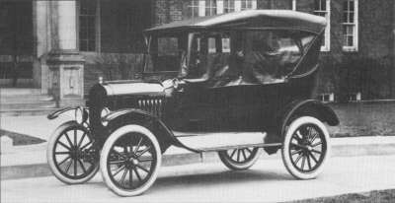
That Was Then

Slide 16
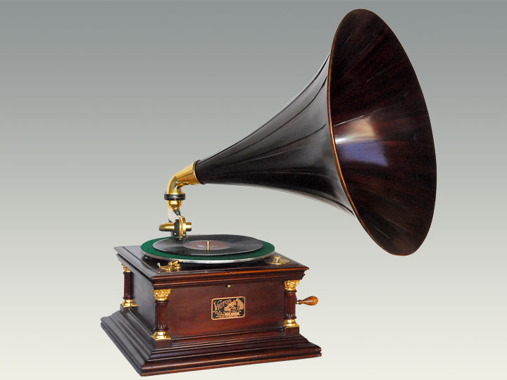
That Was Then

Slide 17
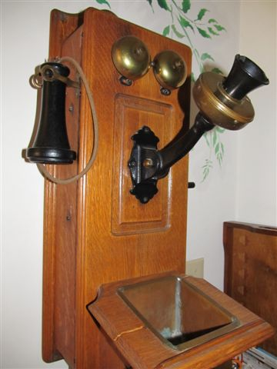
That Was Then

Slide 18
Times are a Changing

Slide 19
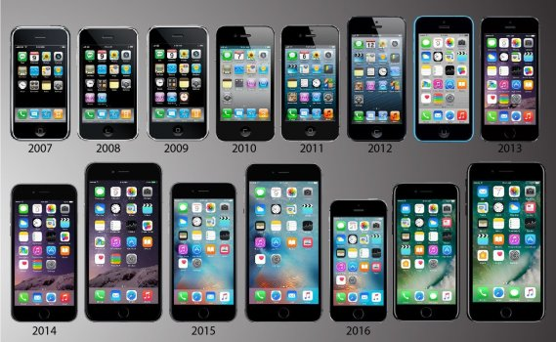
Times are a Changing

Slide 20
Times are a Changing

Slide 21
This is Now

Slide 22
The Valuation Process – Data Analysis & Research
Journal of Market Research, WOMMA, Google, Neilsen, Gartner Group, NAR, NREI, MBA, Advertisting Age, Ibis World, PWC, eMarketer, Forbes, AMA, Facebook, CNET, Social Baker, REIS, The Economist

Slide 23
The Valuation Process – Land Value Opinion

Slide 24
The Valuation Process – Land Value Opinion

Slide 25
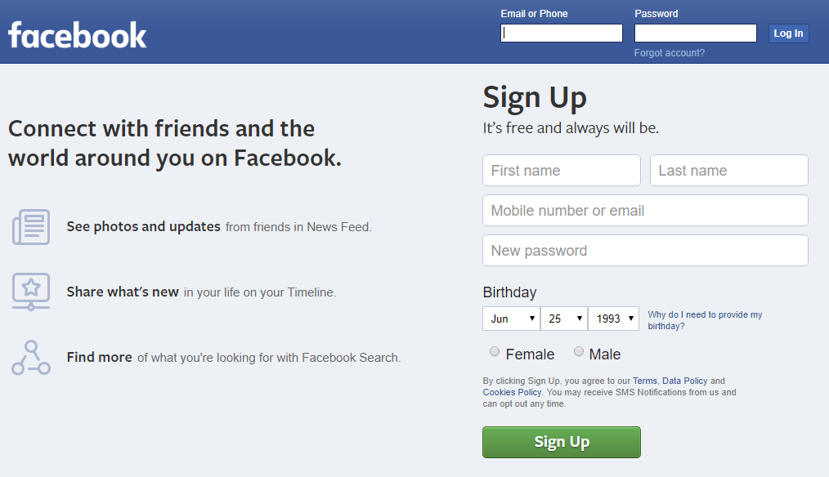
The Valuation Process – Land Value Opinion

Slide 26
The Valuation Process – Cost Approach
How much is a website?
Truly depends on how much time and functionality is deployed
Free to $100s to $1,000s to $10,000s

Slide 27
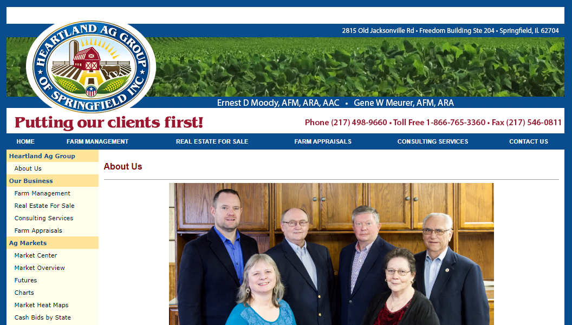
The Valuation Process – Sales Comparison Approach

Slide 28
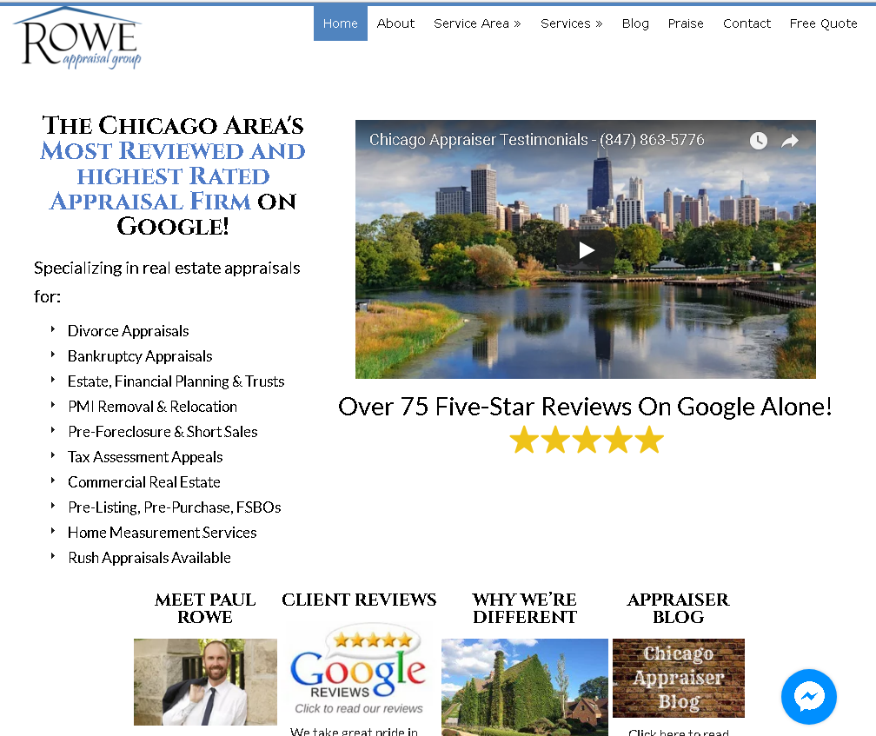
The Valuation Process – Sales Comparison Approach

Slide 29
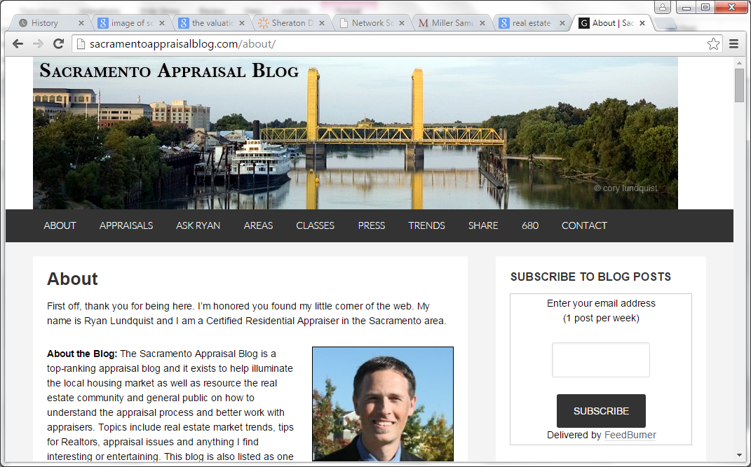
The Valuation Process – Sales Comparison Approach

Slide 30
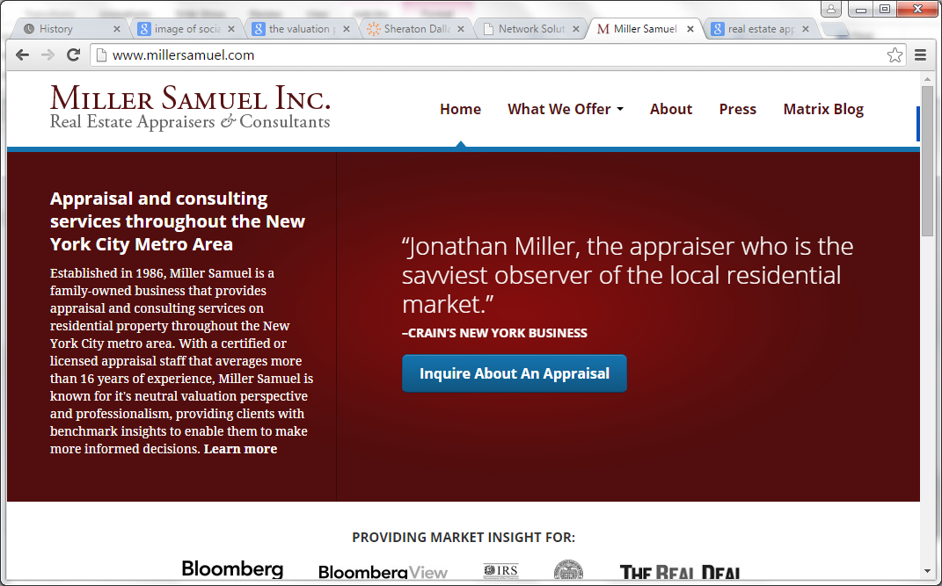
The Valuation Process – Sales Comparison Approach

Slide 31
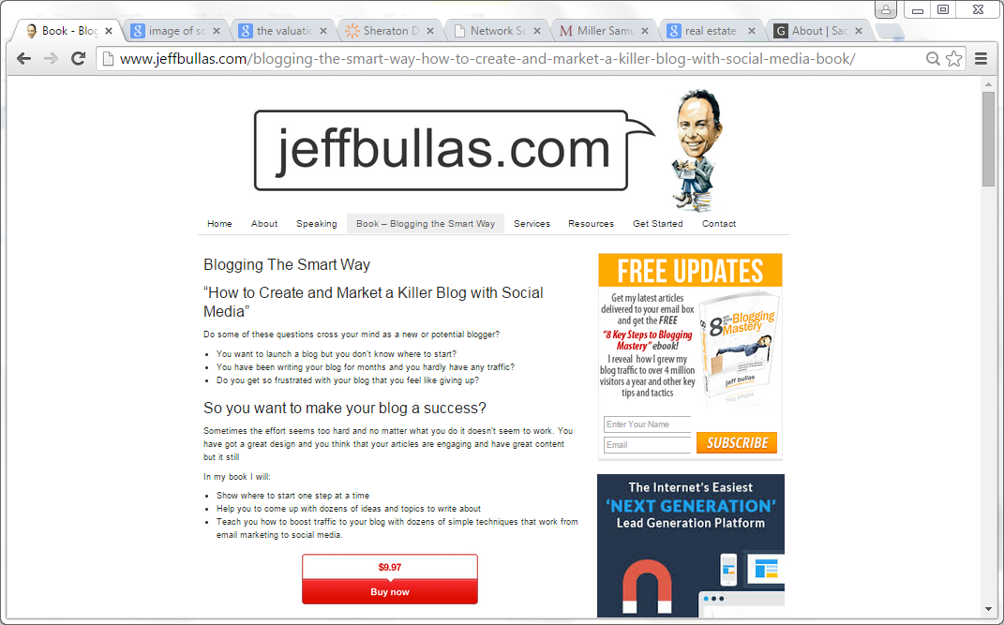
The Valuation Process – Income Capitalization Approach

Slide 32
Reconciliation????

Slide 33
Offline Real Estate vs Online Real Estate
Location vs SEO
Location vs SEM
Location vs PPC

Slide 34
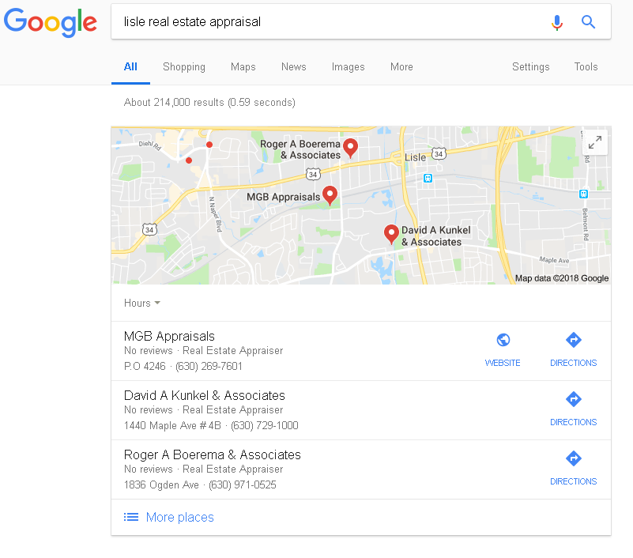
SEO, SEM, PPC

Slide 35
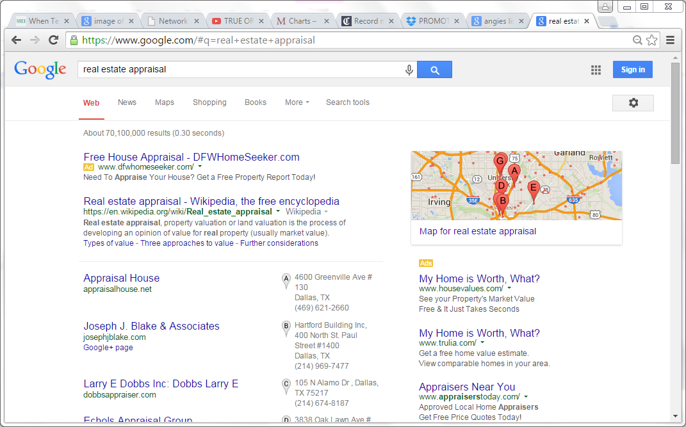
SEO, SEM, PPC

Slide 36
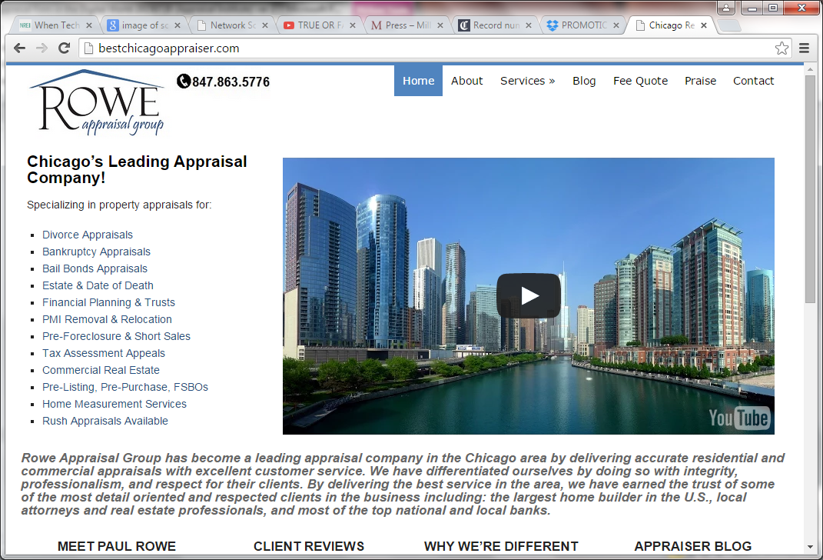
SEO, SEM, PPC

Slide 37
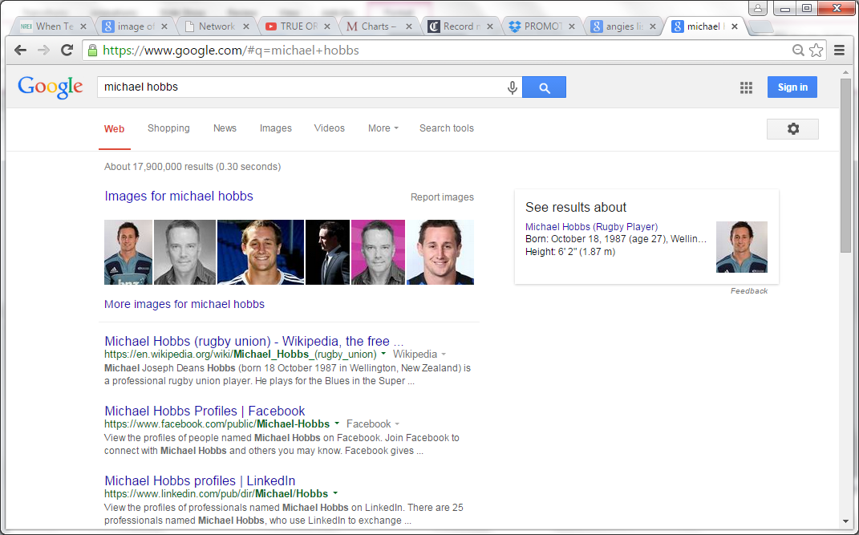
SEO, SEM, PPC

Slide 38
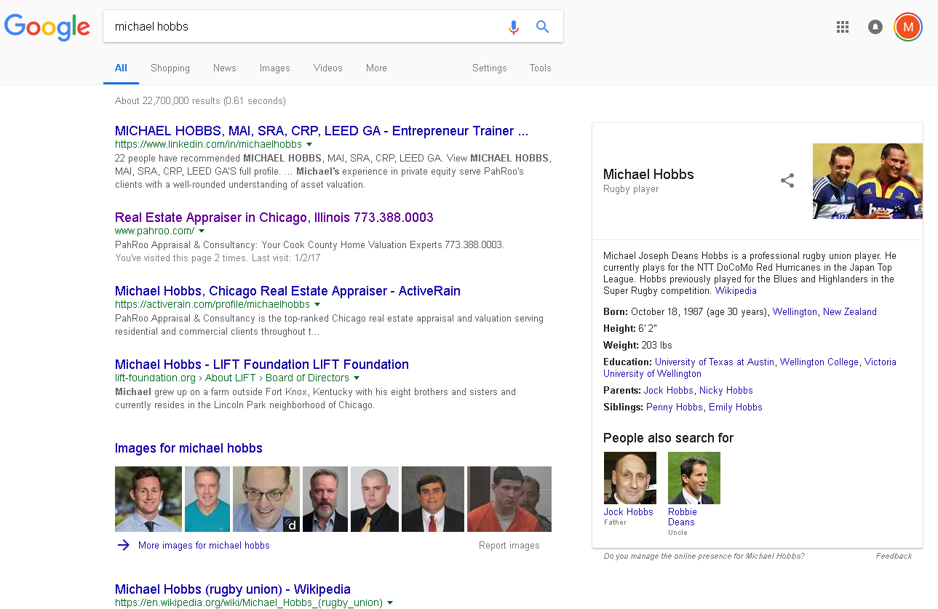
SEO, SEM, PPC

Slide 39
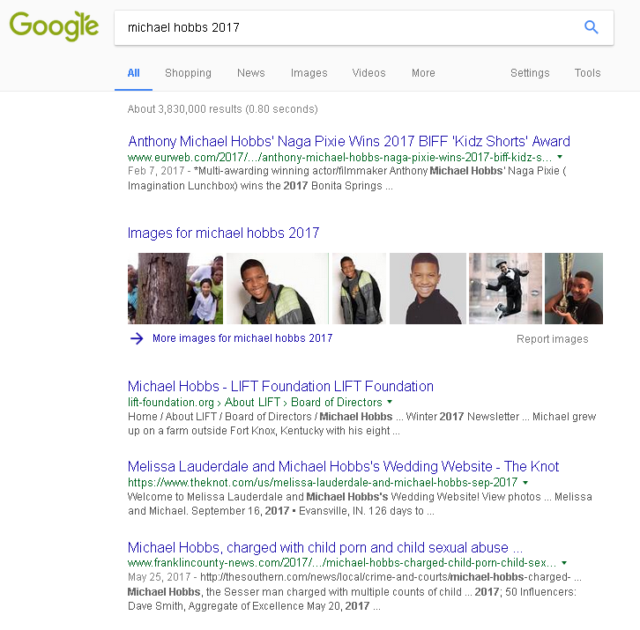
SEO, SEM, PPC

Slide 40
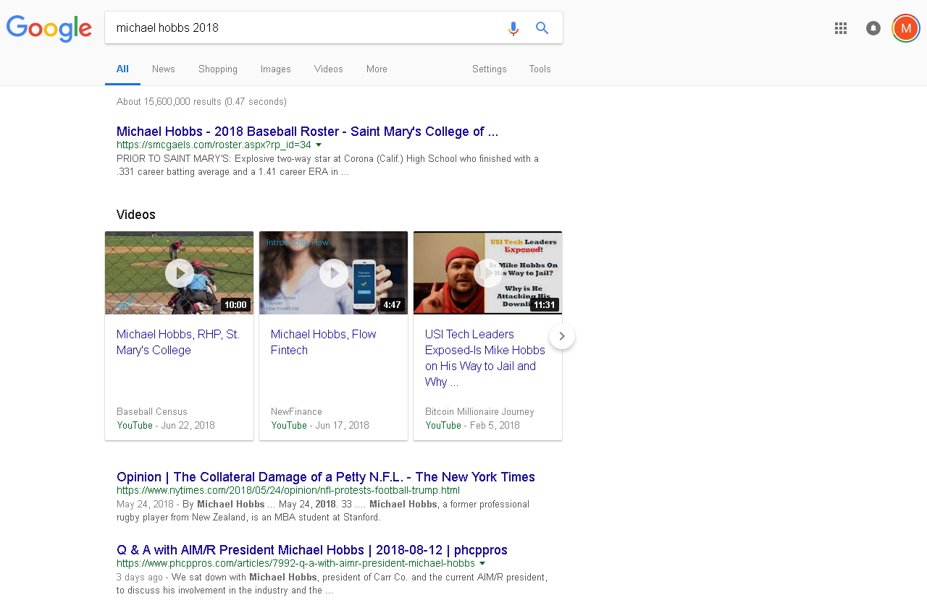
SEO, SEM, PPC

Slide 41
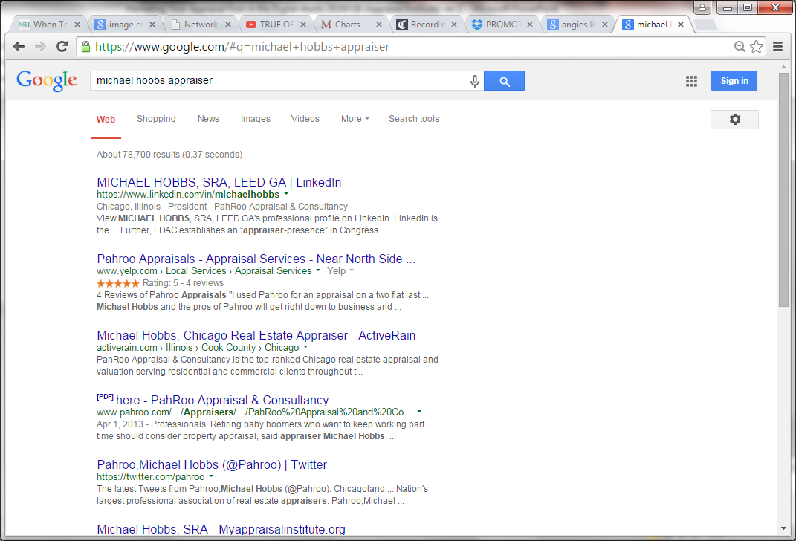
SEO, SEM, PPC

Slide 42
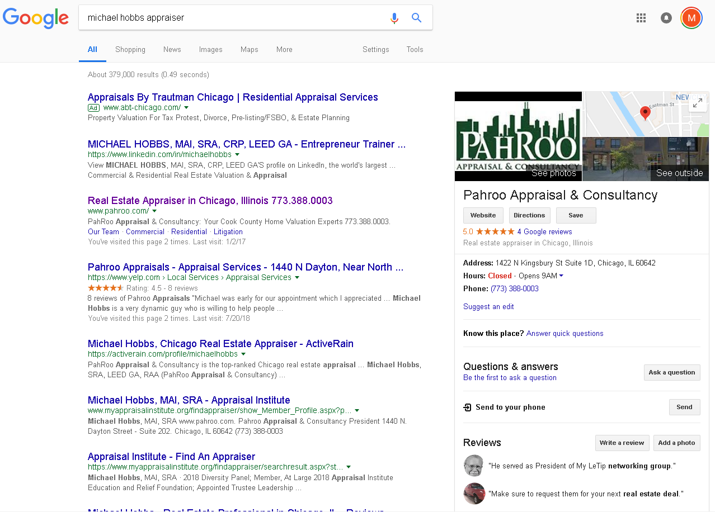
SEO, SEM, PPC

Slide 43
Right now, Rod Tidwell (Cuba Gooding Jr) is saying what you’re thinking to Jerry Maquire (Tom Cruise)

Slide 44
Why It Matters!
64% WOM more effective than traditional marketing (WOMMA)
74% WOM key influence in decision (Ogilvy)
50%+ Searches occurred on mobile (Ogilvy)

Slide 45
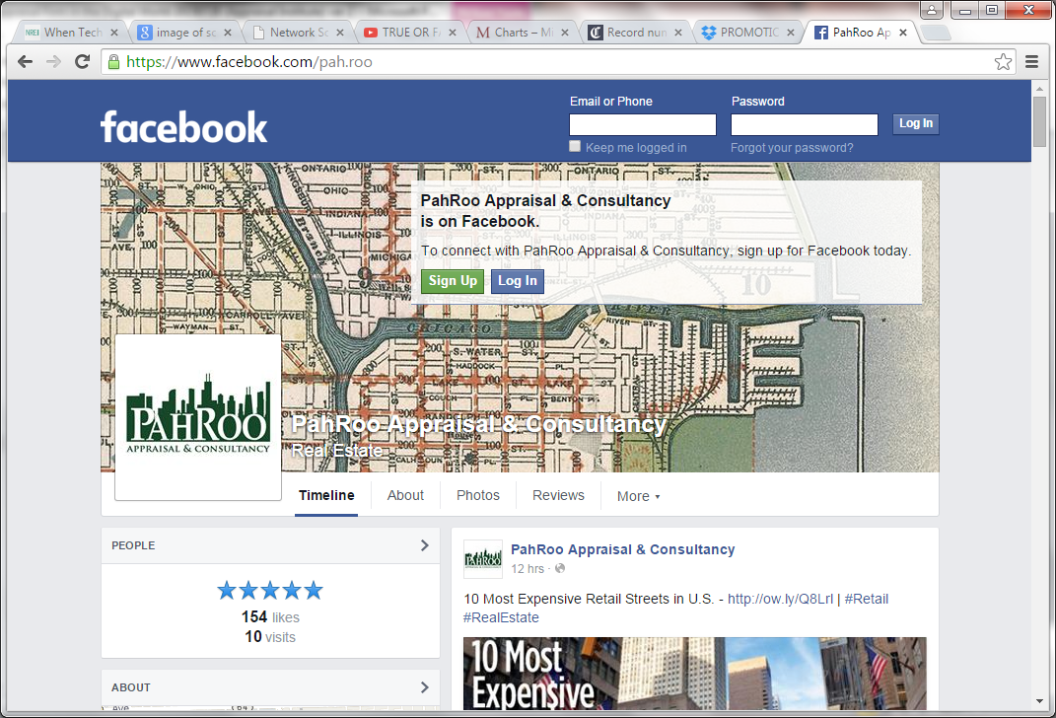
The Power of Digital Marketing

Slide 46
The Power of Digital Marketing

Slide 47
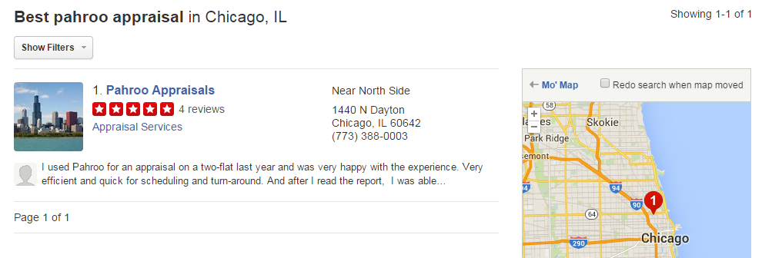
The Power of Digital Marketing
Quality & Quality of reviews matter

Slide 48
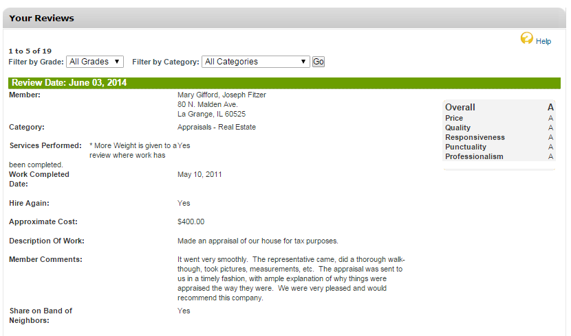
The Power of Digital Marketing

Slide 49
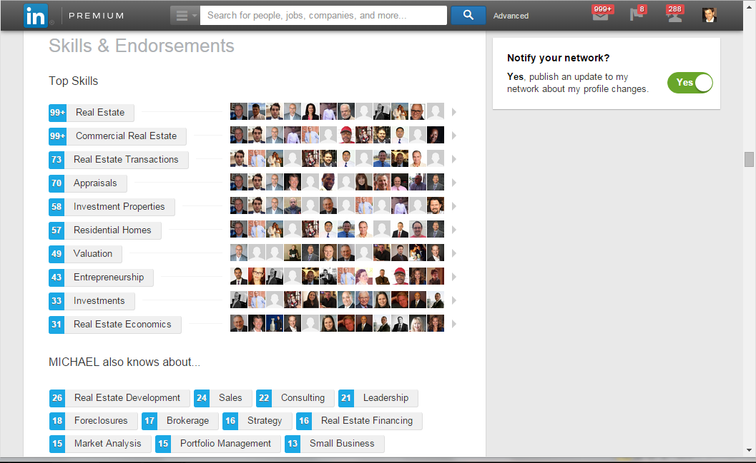
The Power of Digital Marketing

Slide 50
The Power of Digital Marketing

Slide 51
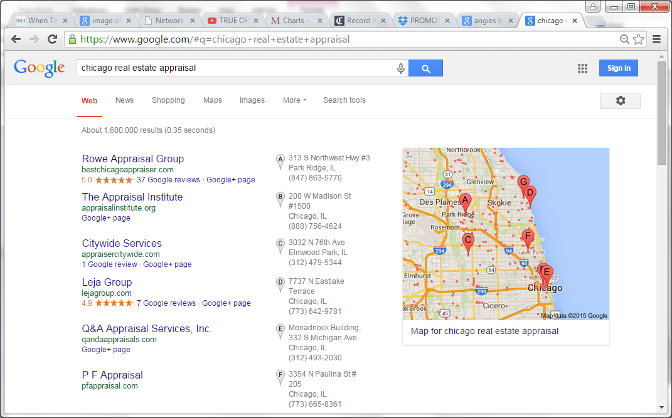
The Power of Digital Marketing
37 reviews…definitely stands out

Slide 52
The Power of Digital Marketing
37 reviews…definitely stands out

Slide 53
The Power of Digital Marketing

Slide 54
Which Toolkit Do You Carry?

Slide 55
Don’t have Data?! Content Ideas from YOUR Appraisal Files
County Trends
Recent Sales Activity
Market Analytics
Interesting / Unusual Photos
Solar Power – Sandy Adomatis, SRA
Supporting Adjustments – Ken Mrozek, MAI, SRA, ASA
Drone Technology – Lamar Ellis III, MAI, SRA

Slide 56
The Hard Part is ALREADY Done. You’ve Got the Data (Content), Share It!

Slide 57
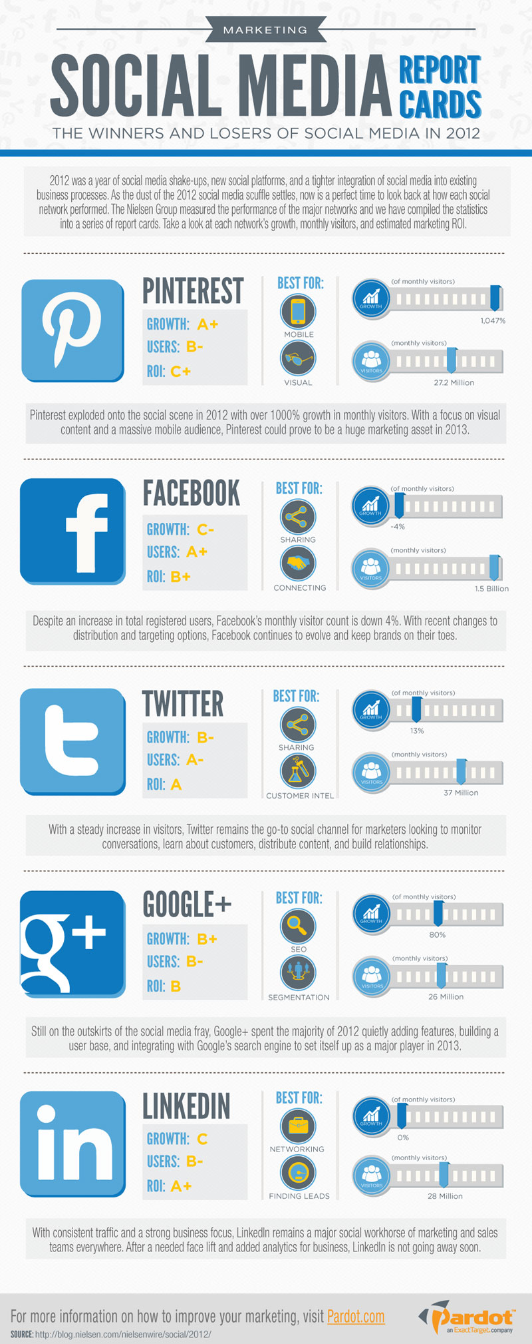

Slide 58
Where To Begin?

Slide 59
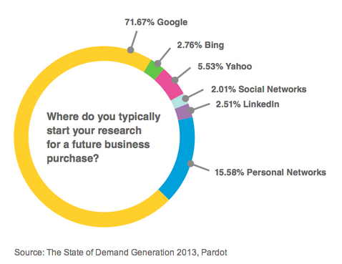
Where It All Begins…..

Slide 60
The Power of Digital Marketing

Slide 61
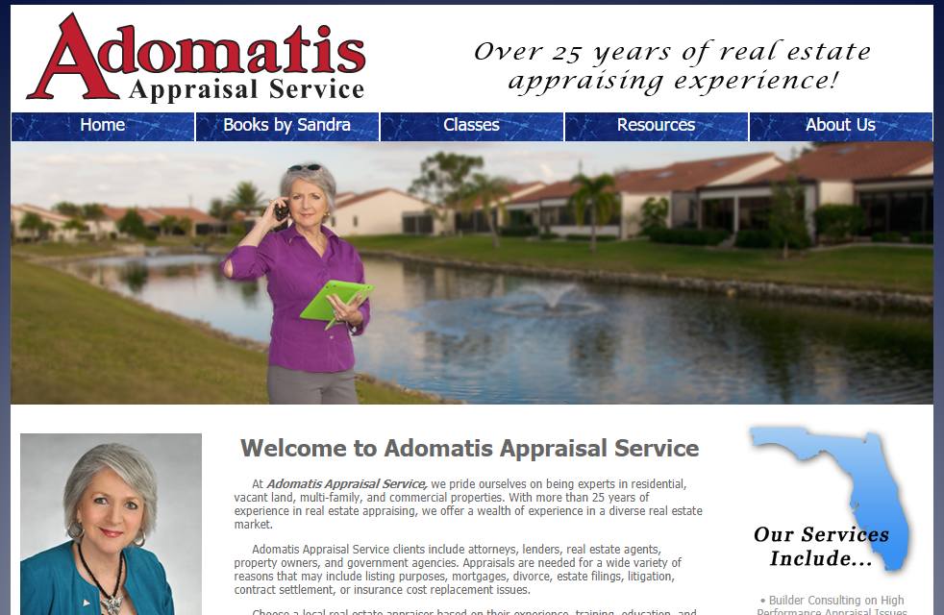
The Power of Digital Marketing

Slide 62
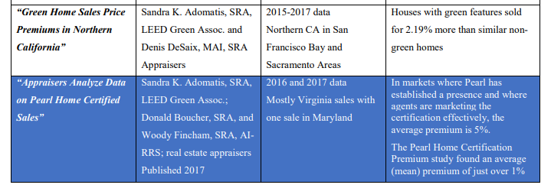
The Power of Digital Marketing

Slide 63
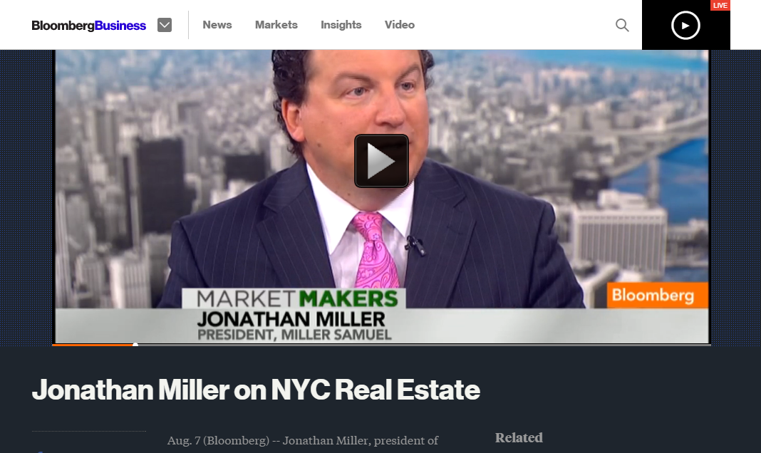
The Geometric Power of Digital Marketing

Slide 64
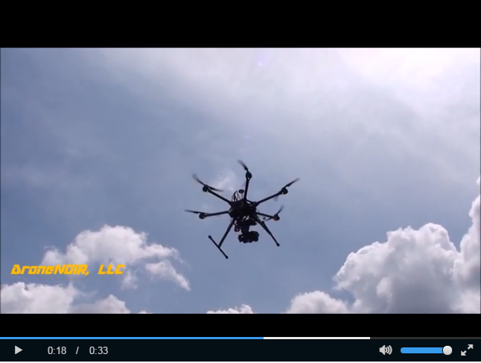
Drone Technology – Lamar Ellis III, MAI, SRA

Slide 65
Lacking Data (Content)? A World of Content in Your Hand!

Slide 66
Now it’s Your Turn! Paired Share What is your 1 action to improve your marketing in the digital world?

Slide 67
THANK YOU FOR ATTENDING!
Michael Hobbs, MAI, SRA, LEED GA,
PahRoo Appraisal & Consultancy
Appraisal@PahRoo.com (773) 388-0003

Slide 68
Sources & Resources
Michael Tasner – No Joke Marketing
David Arvin – It’s Not Who You Know, It’s Who Knows Your
JD Gershbein – Owlish Communications (LinkedIn)
David Meerman Scott – WebInkNow (marketing blog)
Joan Stewart – The Publicity Hound (PR blog)
Jonathan Miller – Housing Notes (real estate blog)
Ryan Lundquist – Sacramento Appraisal Blog (appraisal blog)
Andrew Saltzman – Aardvarks (Blog Writer)
Jim Ardito – Ardito Creative (Professional Writer & Blogger)

